Slide 1
Adversarial Search
Chapter 5.1-5.3

Slide 2
Games vs. search problems
"Unpredictable" opponent → specifying a move for every possible opponent reply
Time limits → unlikely to find goal, must approximate

Slide 3
Game search
Game-playing programs developed by AI researchers since the beginning of the modern AI era
  Programs playing chess, checkers, etc (1950s)
Specifics:
  Sequences of player’s decisions we control
  Decisions of other player(s) we do not control
Contingency problem: many possible opponent’s moves must be “covered” by the solution
Opponent’s behavior introduces uncertainty
Rational opponent – maximizes its own utility (payoff) function

Slide 4
Game Search Problem
Problem formulation
  Initial state: initial board position + whose move it is
  Operators: legal moves a player can make
  Goal (terminal test): game over?
  Utility (payoff) function: measures the outcome of the game and its desirability
Search objective:
  Find the sequence of player’s decisions (moves) maximizing its utility (payoff)
  Consider the opponent’s moves and their utility

Slide 5
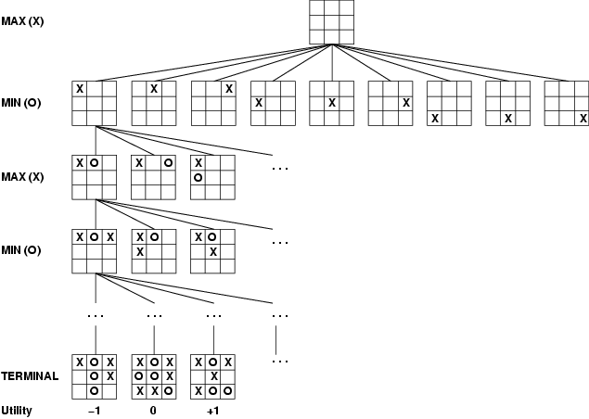
Game tree (2-player, deterministic, turns)

Slide 6
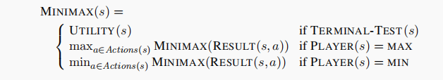
How to Calculate MINIMAX Value

Slide 7
Minimax Algorithm
How to deal with the contingency problem?
  Assuming the opponent is always rational and always optimizes its behavior (opposite to us), we consider the best opponent’s response.
  Then the minimax algorithm determines the best move.
  Steps:
  Generate the Game Tree
  Evaluate Terminal States
  Propagate Utility Values Upwards

Slide 8
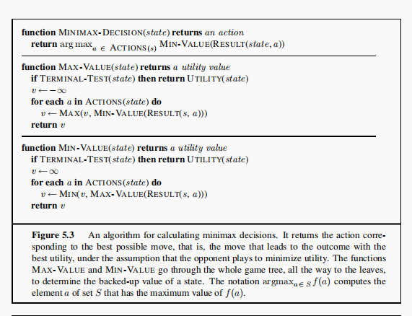

Slide 9
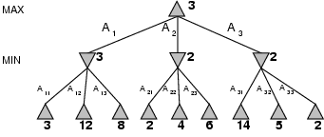
Minimax
Perfect play for deterministic games
Idea: choose move to position with highest minimax value
= best achievable payoff against best play
E.g., 2-ply game: [will go through another eg in lecture]

Slide 10
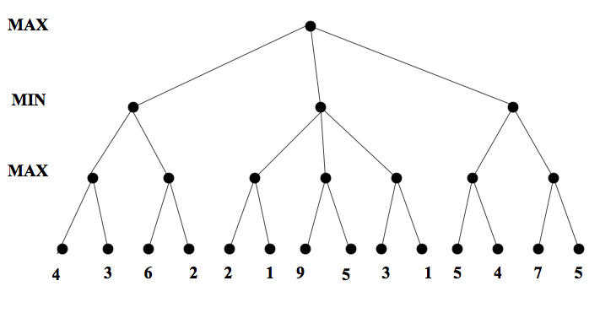
Minimax. Example

Slide 11
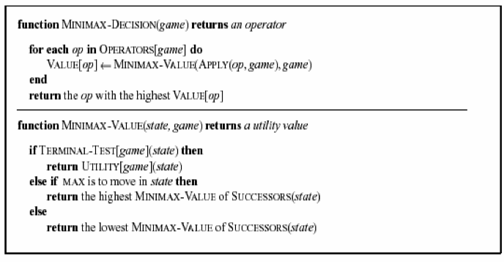

Slide 12
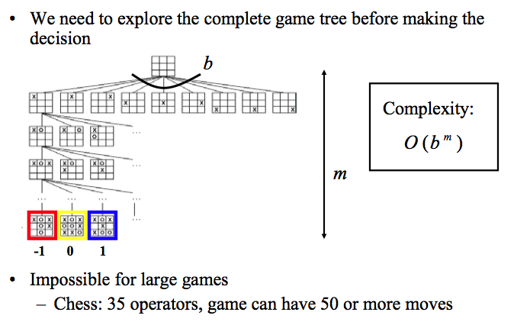
Complexity of the minimax algorithm

Slide 13
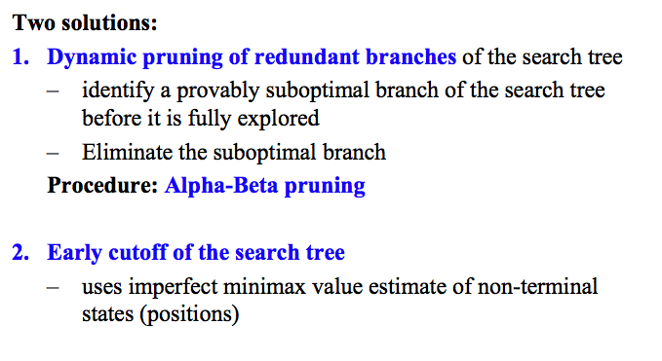
Solution to the complexity problem

Slide 14
Alpha Beta Pruning
Some branches will never be played by rational players since they include sub-optimal decisions for either player
First, we will see the idea of Alpha Beta Pruning
Then, we’ll introduce the algorithm for minimax with alpha beta pruning, and go through the example again, showing the book-keeping it does as it goes along

Slide 15
Alpha beta pruning. Example

Slide 16
Minimax with alpha-beta pruning: The algorithm
Maxv: function called for max nodes
  Might update alpha, the best max can do far
Minv: function called for min nodes
  Might update beta, the best min can do so far
Each tests for the appropriate pruning case
We’ll go through the algorithm on the course website

Slide 17
Algorithm example: alphas/betas shown

Slide 18
Properties of α-β
Pruning does not affect final result
Good move ordering improves effectiveness of pruning
With "perfect ordering," time complexity = O(b^{m/2})
  → doubles depth of search
A simple example of the value of reasoning about which computations are relevant (a form of metareasoning)

Slide 19
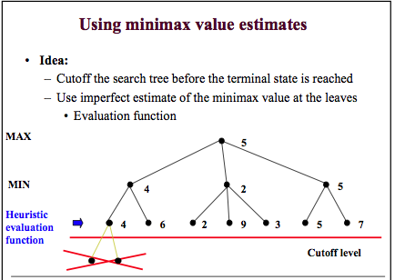

Slide 20
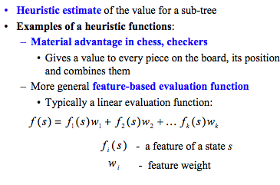
Design of evaluation functions

Slide 21
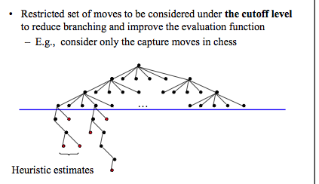
Further extensions to real games

